Slide 1
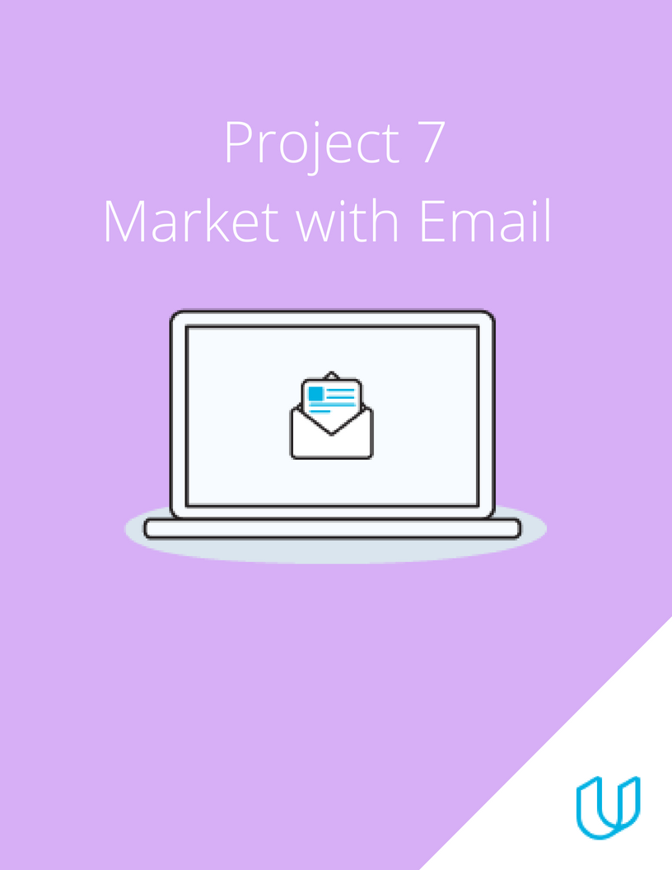
Project 7: Email Marketing

Slide 2
Part 1
Plan Your Email Campaign

Slide 3
Marketing Objective & KPI
Marketing Objective - To convert leads for digital marketing nanodegree program using advert on your best social media advertising guide through 3 email campaign within june 7th and june 26th
KPI - conversion rate

Slide 4

Target Persona
Background and Demographics | Target Persona Name | Needs
Female, 26 yrs old Not married Fashion designer Interested in technology,that where the world is heading towards ₦500,000 annually Bsc degree | Olatunji Glory Tomisin | Would like to learn about digital marketing. Would like to get connected to industry for freelancing options Would like to earn a credible certificate from digital marketing Meet the digital world requirement Career support and mentorship
Hobbies | Goals | Barriers
Travel,dressmaking Love to sing Like to read and be involved with women empowerment Designing | To expand my business and move it to the next level Be able to apply digital marketing to my business Learn digital marketing and earn credible degrees outside of my field of study. Better management | Workload is much and hence time is premium Lack of proper equipment to start course like laptop and premium data Little knowledge in technology Lack of time Never taken an online course before

Slide 5
Email Series
Email 1: The best ebook on Social Media Advertising Guide. hey!it’s free, Download your free ebook copy
Email 2: Start a career in Digital Marketing Nanodegree with Udacity. Sign up to launch your new career
Email 3: This is a great opportunity don’t miss it.Udacity digital marketing nanodegrees registration closes june 25th

Slide 6
Part 2
Create Your Email Campaign

Slide 7
Content Plan: Email 1
Overarching Theme: 3-5 Sentences
General | This email is intended to raise the awareness of the digital marketing nanodegree program to my subscribers. The objective is to raise awareness and build engagement about the free ebook with my subscribers
Subject Line 1 | The best ebook on social media advertising Guide
Subject Line 2 (for A/B testing) | Congratulation here is your free ebook guide
Preview Text | Hey! It’s free ,Download your free ebook copy.
Body | Get the best free social media advertising guide Social media advertising is becoming one of the largest form of advertising or marketing ones product. Is all this true? Yes it is and with this guide you will be on your way to becoming a social media advertising expert And to make all this better ,the guide also touches on marketing strategies ,content marketing and how to stay afloat of your campaigns and client business. You can now go through your guide.
Outro CTA 1 | Download now
Outro CTA 2 (for A/B testing) | Learn more

Slide 8
Content Plan: Email 2
Overarching Theme: 3-5 Sentences
General | This email is provided to give information about the udacity digital marketing nanodegree program. The objective is to encourage subscribers to sign up for the program
Subject Line 1 | Start a career in digital marketing with udacity
Subject Line 2 | Become a digital marketer
Preview Text | Sign up to launch your new career
Body | What you need to learn about digital marketing Hi there, am certain you must have gone through if not all half way through the social media advertising guide . To become a digital marketer there are certain areas that are compulsory for you to know like how to create effective content, and utilize effective marketing strategy to ensure that your customers are more focused on your brand Digital marketing is very broad and elaborate and it can be confusing if you don’t know where to start from. That’s why the email can be of great help to you i would like to introduce to you the udacity digital marketing nanodegree progam which is a great platform that can help you in your journey,with udacity learning is fun , interactive and convenient . sign up today to kick start your career.
Outro CTA Outro CTA 2 | Sign up now Register now

Slide 9
Content Plan: Email 3
Overarching Theme: 3-5 Sentences
General | This email serves as a reminder to subscribers who in email 1 where able to download the ebook and also click the sign up button but has not completed the sign up for DMND The objective is to encourage subscribers to complete their sign up into dmnd
Subject Line 1 | This is a great opportunity don’t, don’t miss it
Subject Line 2 | Enrol today for the udacity digital marketing nanodegree
Preview Text | Udacity digital marketing nanodegree registration closes june 25th
Body | Hey there, Don’t miss your chance to acquire great skill in digital marketing that will allow you expand your business online and also puts you up to date with the worlds marketing trend. Register now, registration closes 11:59pm, june 25th and join the class, class begins july 1
Outro CTA Outro CTA | Register now Sign up now

Slide 10
A/B Test Overview
Creating another subject line (subject line 2) and another CTA (Outro CTA2).
Therefore my mail list was divided into 2 groups I will send to group A and group B the email with subject line 1 (the best e book on social media advertising guide) and Outro 1 of download now and send the email with the subject line 2 (congratulations here is your free e book guide) and Outro CTA 2 (learn more).
The performance and response I get from the two group A and B would be tested and the email version that produce the higher no open rate is what I will continue to sending my full mailing list .
A/B testing it's important as it would enable me understand what will affect my email open rate but understand what works and don't.

Slide 11
Calendar & Plan
Email Name | Planning Phase | Testing Phase | Send Phase | Analyze Phase
Email 1 | June 7-8 | June 9 | June 10 | June 12-13
Email 2 | June 9-10 | June 11 | June 12 | June 14-15
Email 3 | June 15-16 | June 17 | June 23 | June 24-25
Week One |  |  |  |  |  | Week Two |  |  |  |  | Week Three
M | T | W |  | T | F | M | T | W | T | F | M | T | W | T | F
7 | 8 | 9 | 10 | 11 | 12 | 13 | 14 | 15 | 16 | 17 | 23 | 24 | 25 | 26 | 27
Email one
Color Key | Planning Phase | Testing | Send Phase | Analyze Phase

Slide 12
Part 3
Build & Send

Slide 13
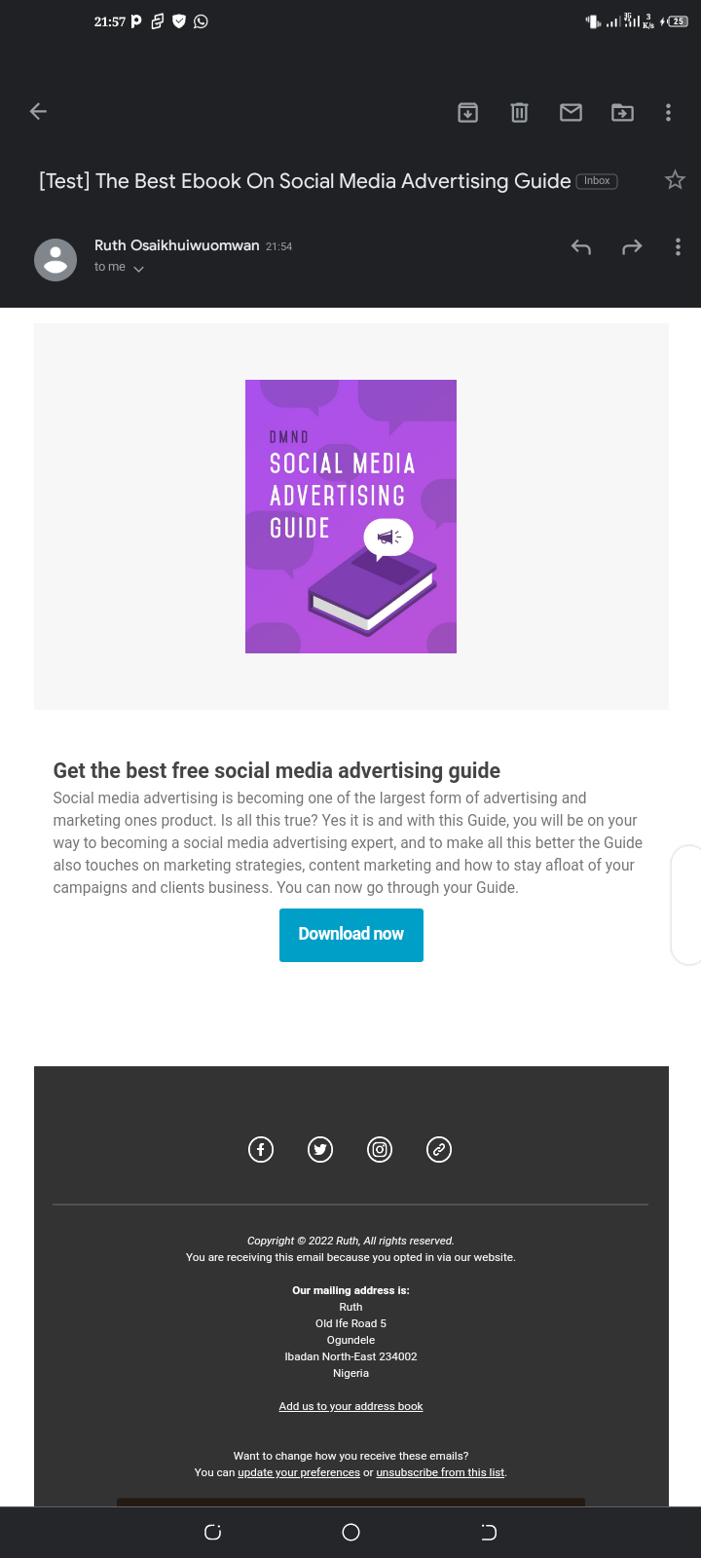
Draft Email

Slide 14
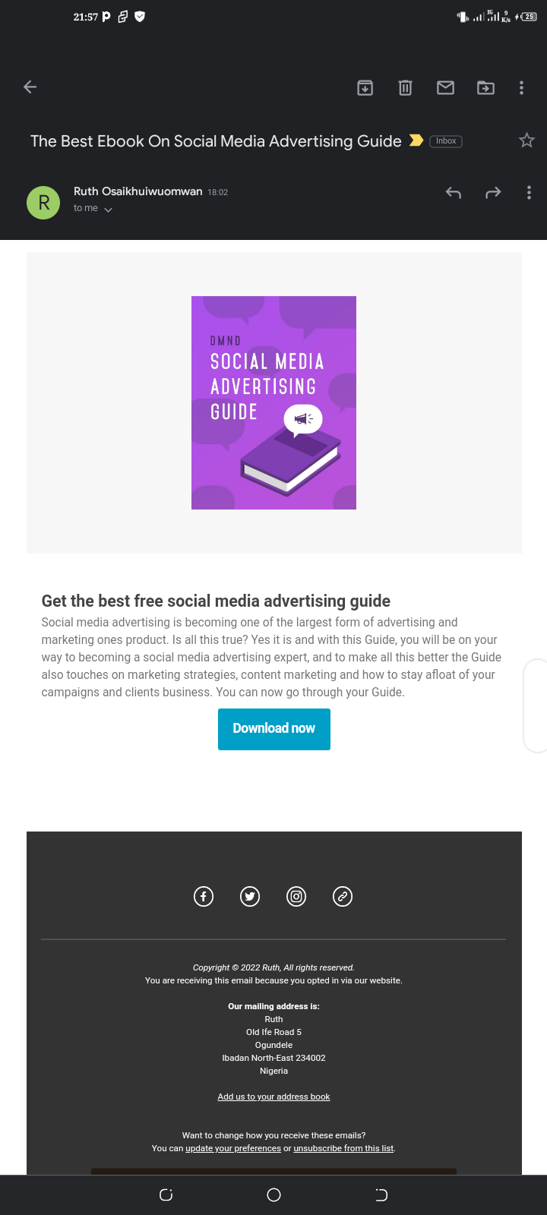
Final Email

Slide 15
Part 4
Sending & Analyzing Results

Slide 16
Results Email #1
After you have hit send on the first email of your campaign, you can spend some time analyzing the results.
Calculate the Open Rate
Results and Analysis
Sent | Delivered | Opened | Opened Rate | Bounced
2500 | 2250 | 495 | 22% | 225

Slide 17
Results Continued Email #1
Results can be monitored within the first 24 hours of an email send, after a couple days or even after a week.
Calculate the CTR and the Conversion Rate
Results and Analysis
Clicked | CTR | Take Action | Conversion | Unsub
180 | 8.0% | 75 | 3.33 | 30

Slide 18
Final Recommendations
I will split my mailing list into the 2 groups and carryout a/b tesing creating 2 version of emails using the subject line 1 and CTA 1 for version A and subject line 2 CTA 2
If any subscriber unsubscribe from my list, I will remove them from the list by as this would save cost from targeting the wrong audience and avoid being Black listed as spam message
My email 2 I would add a non personal image illustrating digital marked while for email 3 I will add some testimonial of success ful student who has taken the course. And start to earn as a digital marketer.

